Slide 1
BÖLÜM 3
TANIMSAL ÖLÇÜLER
Basic Business Statistics, 11e © 2009 Prentice-Hall, Inc.
Chap 3-<number>

Slide 2
Öğrenme Amaçları
Merkezi Eğilim, Değişkenlik, Asimetri ve Basıklık Ölçüleri ve Özellikleri
Anakütle için Tanımsal Ölçülerin Hesaplanması
Frekans ve Gruplanmış Serilerin Tanımsal Ölçüler Hesabı
Kutu Diyagramının Oluşturulması ve Yorumu
Kovaryans ve Korelasyonun Hesaplanması
Basic Business Statistics, 11e © 2009 Prentice-Hall, Inc..
Chap 3-<number>

Slide 3
Özet Tanımlar
Merkezi Eğilim (Ortalama);Verileri temsil eden tek bir değer
Değişkenlik Merkezi eğilim ölçüsünün temsil gücü hakkında bilgi verir ve değişken değerlerinin ne kadar homojen dağıldığını gösterir.
Asimetri ve Basıklık Ölçüleri verilerin dağılımı hakkında bilgi verir (Ortalamanın üzerinde veya altında bir toplanma olup olmadığı…)
Basic Business Statistics, 11e © 2009 Prentice-Hall, Inc..
Chap 3-<number>

Slide 4
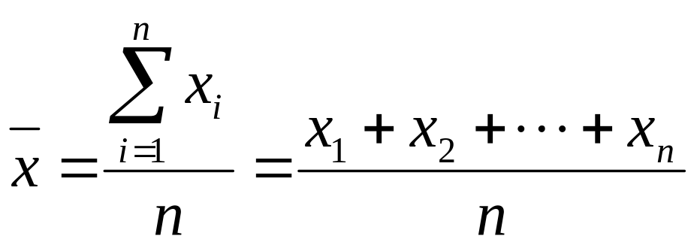
Merkezi Eğilim Ölçüleri:
Aritmetik Ortalama
En sık kullanılan merkezi eğilim ölçüsüdür.
  n büyüklüğünde bir örnek için
Örnek ortalaması
i. değer
Örnek büyüklüğü
Gözlenen değerler
Basic Business Statistics, 11e © 2009 Prentice-Hall, Inc..
Chap 3-<number>

Slide 5
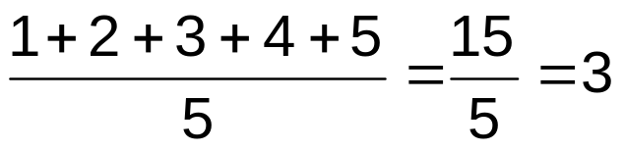
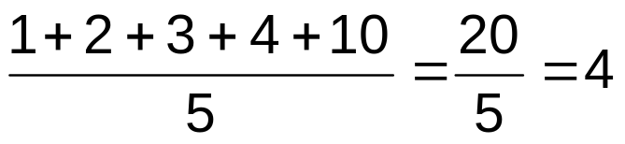
Merkezi Eğilim Ölçüleri:
Aritmetik Ortalama
(devamı)
En çok bilinen merkezi eğilim ölçüsüdür.
Sapan değerlerden (outlier) etkilenir
0 1 2 3 4 5 6 7 8 9 10
0 1 2 3 4 5 6 7 8 9 10
ortalama= 3
ortalama = 4
Basic Business Statistics, 11e © 2009 Prentice-Hall, Inc..
Chap 3-<number>

Slide 6
Merkezi Eğilim Ölçüleri:
Medyan
Sıralanmış verilerde, medyan “tam ortadaki değere ” karşılık gelir verilerin (50% sinin üzerinde, 50% sinin altında)
Sapan değerlerden (outlier) etkilenmez.
0 1 2 3 4 5 6 7 8 9 10
0 1 2 3 4 5 6 7 8 9 10
Medyan = 3
Medyan = 3
Basic Business Statistics, 11e © 2009 Prentice-Hall, Inc..
Chap 3-<number>

Slide 7

Merkezi Eğilim Ölçüleri:
Medyan’ın Hesaplanması
Veriler küçükten büyüğe sıralandığında
Veri sayısı tek ise, medyan tam ortadaki değere karşılık gelir
Veri sayısı çift ise tam ortadaki iki sayının ortalamasına eşittir.
Basic Business Statistics, 11e © 2009 Prentice-Hall, Inc..
Chap 3-<number>

Slide 8
Merkezi Eğilim Ölçüleri:
Mod
En sık tekrarlanan değer
Sapan değerlerden etkilenmez.
Nicel ve Nitel veriler (nominal ölçekli) için hesaplanabilir
Mod hesaplanamayabilir.
Birden fazla mod olabilir
0 1 2 3 4 5 6 7 8 9 10 11 12 13 14
0 1 2 3 4 5 6
Mod Yok
Mod = 9
Basic Business Statistics, 11e © 2009 Prentice-Hall, Inc..
Chap 3-<number>

Slide 9
Merkezi Eğilim Ölçüleri:
Örnek
Ev fiyatları:
$2,000,000
$500,000
$300,000
$100,000
$100,000
Toplam $3,000,000
Ortalama ($3,000,000/5)
= $600,000
Medyan: Sıralanmış değerlerin ortası= $300,000
Mod: En sık tekrarlanan değer
= $100,000
Basic Business Statistics, 11e © 2009 Prentice-Hall, Inc..
Chap 3-<number>

Slide 10
Merkezi Eğilim Ölçüleri:
Hangisi Seçilmeli?
Sapan değer (outlier) olmadığında en sık kullanılan Aritmetik Ortalamadır
Medyan sapan değerlerden etkilenmediğinden sıklıkla kullanılır. Bu uygulamada medyanın kullanılması daha doğrudur.
Bazı durumlarda hem medyan hem aritmetik ortalamanın birlikte yorumlanması uygundur.
Basic Business Statistics, 11e © 2009 Prentice-Hall, Inc..
Chap 3-<number>

Slide 11
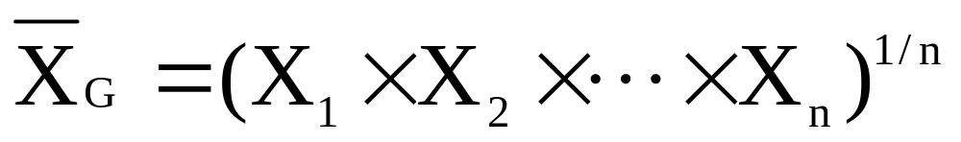
Merkezi Eğilim Ölçüsü: Ortalama Değişim Oranı;
Geometrik Ortlama& Geometrik Ortalama Getiri Oranı
Geometric mean
Geometric mean rate of return
  Yatırımın zamana göre getirisini ölçer
  i. zaman periyodundaki getiri
Basic Business Statistics, 11e © 2009 Prentice-Hall, Inc..
Chap 3-<number>

Slide 12
The Geometric Mean Rate of Return: Example
$100,000 bir yatırım birinci yılın sonunda $50,000’a düşüyor ikinci yılın sonunda yine $100,000’a çıkıyor
50% azaldı 100% arttı
2 yılın getirisi sıfırdır çünkü başlangıç ve bitiş değeri aynıdır
Basic Business Statistics, 11e © 2009 Prentice-Hall, Inc..
Chap 3-<number>

Slide 13
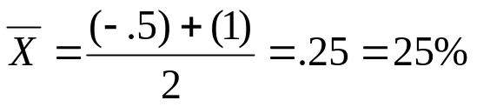
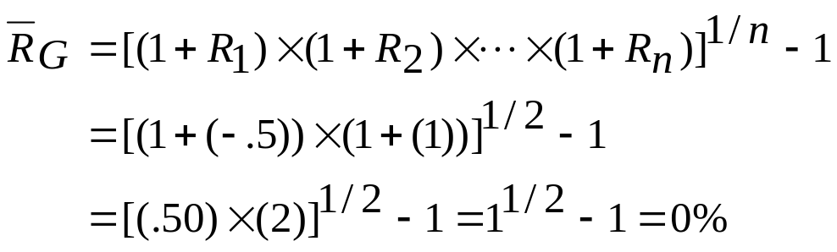
The Geometric Mean Rate of Return: Example
(continued)
Bir yıllık getirileri temel alarak aritmetik ortalama hesaplandığında
Aritmetik Ort. Getiri Oranı:
YANLIŞ SONUÇ
Geometric Ort. Getiri Oranı:
Daha temsil edici sonuç
Basic Business Statistics, 11e © 2009 Prentice-Hall, Inc..
Chap 3-<number>

Slide 14

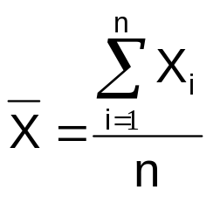
Merkezi Eğilim Ölçüleri: ÖZET
Merkezi Eğilim
Aritmetik
Ortalama
Medyan
Mod
Geometric Ortalama
Sıralanmış Verilerde Ortadaki değer
En sık gözlenen değer
Ortalama değişim oranı
Basic Business Statistics, 11e © 2009 Prentice-Hall, Inc..
Chap 3-<number>

Slide 15
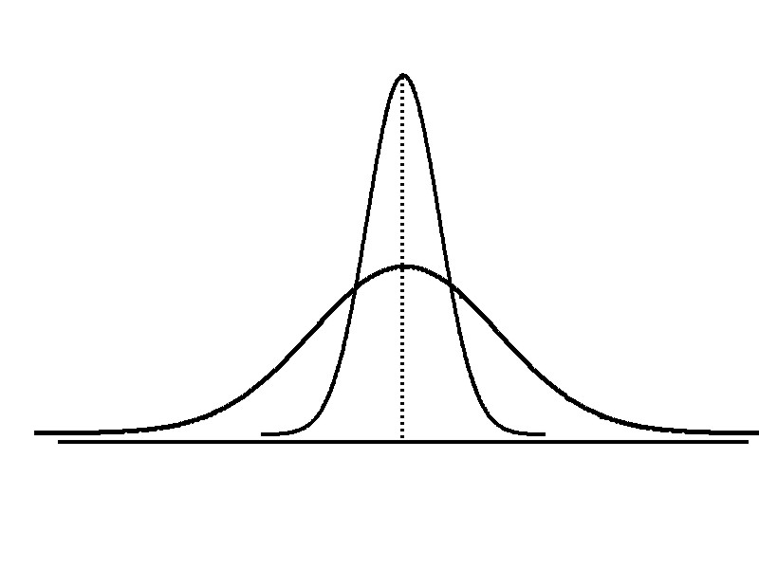
Değişkenlik Ölçüleri
Değişkenlik
Range
(Aralık)
Varyans
Standart Sapma
Değişkenlik Katsayısı
Same center,
different variation
Basic Business Statistics, 11e © 2009 Prentice-Hall, Inc..
Chap 3-<number>

Slide 16
Değişkenlik Ölçüleri:
Range (Aralık)
En basit değişkenlik ölçüsüdür
En büyük değer ile en küçük değer arasındaki fark:
Aralık= X_{enbüy} – X_{enküç}
Örnek:
0 1 2 3 4 5 6 7 8 9 10 11 12 13 14
Aralık= 13 - 1 = 12
Basic Business Statistics, 11e © 2009 Prentice-Hall, Inc..
Chap 3-<number>

Slide 17
Measures of Variation:
Aralık (Range)
Verilerin dağılımını göz ardı eder.
Sapan değerlere (outlier) karşı hassas
7 8 9 10 11 12
7 8 9 10 11 12
Range = 12 - 7 = 5
Range = 12 - 7 = 5
1,1,1,1,1,1,1,1,1,1,1,2,2,2,2,2,2,2,2,3,3,3,3,4,5
Aralık = 5 - 1 = 4
1,1,1,1,1,1,1,1,1,1,1,2,2,2,2,2,2,2,2,3,3,3,3,4,120
Aralık = 120 - 1 = 119
Basic Business Statistics, 11e © 2009 Prentice-Hall, Inc..
Chap 3-<number>

Slide 18
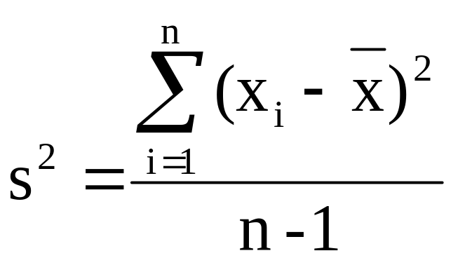

Değişkenlik Ölçüleri :
Varyans
Değerlerin ortalamadan ortama ne kadar saptığını gösteren ölçü
  Örnek varyansı:
Burada
= aritmetik ortalama
n = örnek büyüklüğü
xi=x’in i . değeri
Basic Business Statistics, 11e © 2009 Prentice-Hall, Inc..
Chap 3-<number>

Slide 19
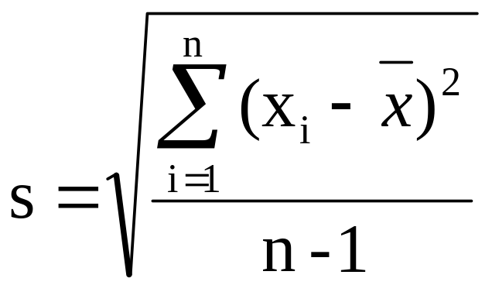
Değişkenlik Ölçüleri :
Standart Sapma
En sık kullanılan değişkenlik ölçüsü
Ortalama etrafındaki dağılımı gösterir
Varyansın kareköküdür
Verilerin birimleri ile standart sapmanın birimi aynıdır
  Örnek standart sapması:
Basic Business Statistics, 11e © 2009 Prentice-Hall, Inc..
Chap 3-<number>

Slide 20
Değişkenlik Ölçüleri :
Standart Sapma
Standart sapmanın hesaplama adımları
1. Her bir değerle ortalama arasındaki fark hesaplanır
2. Her bir farkın karesi alınır
3. Bu farklar toplanır
4. Bu toplam (n-1)’e bölünür.
5. Elde edilen örnek varyansının karekökü alınarak standart sapma değerine ulaşılır.
Basic Business Statistics, 11e © 2009 Prentice-Hall, Inc..
Chap 3-<number>

Slide 21
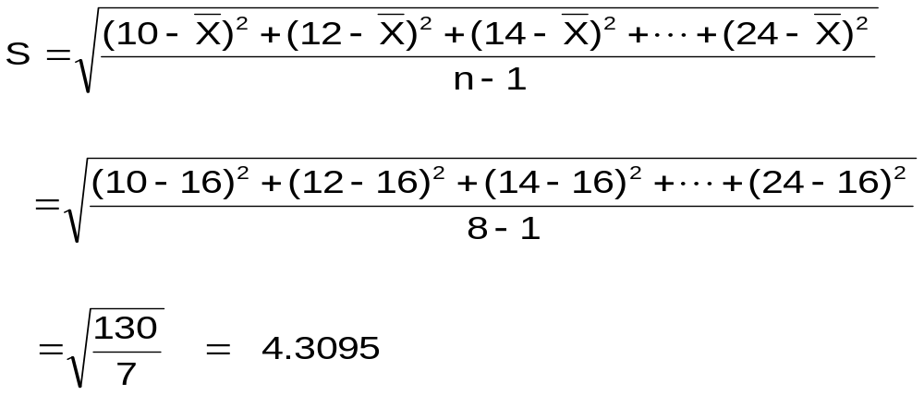
Değişkenlik Ölçüleri :
Örnek standart sapması:
Örnek
Örnek
Veriler (X_{i}) : 10 12 14 15 17 18 18 24
n = 8 Ortalama= X = 16
Ortalamadan ortalama olarak ne kadar fark var
Basic Business Statistics, 11e © 2009 Prentice-Hall, Inc..
Chap 3-<number>

Slide 22
Standart sapmaların Karşılaştırılması
Veri A
Ortalama= 15.5
S = 3.338
11 12 13 14 15 16 17 18 19 20 21
Veri B
Ortalama = 15.5
S = 0.926
11 12 13 14 15 16 17 18 19 20 21
Veri C
Ortalama= 15.5
S = 4.570
11 12 13 14 15 16 17 18 19 20 21
Basic Business Statistics, 11e © 2009 Prentice-Hall, Inc..
Chap 3-<number>

Slide 23
Standart Sapmaların Karşılaştırılması
Küçük standart sapma
Büyük standart sapma
Basic Business Statistics, 11e © 2009 Prentice-Hall, Inc..
Chap 3-<number>

Slide 24
Değişkenlik Ölçüleri:
Özellikler
Değerler birbirine yaklaştıkça aralık, varyans ve standart sapma değerleri küçülür
Tüm değerler aynı ise (değişkenlik yok), tüm değişkenlik ölçüleri sıfır olur
Değişkenlik ölçüleri negatif olamaz.
Basic Business Statistics, 11e © 2009 Prentice-Hall, Inc..
Chap 3-<number>

Slide 25
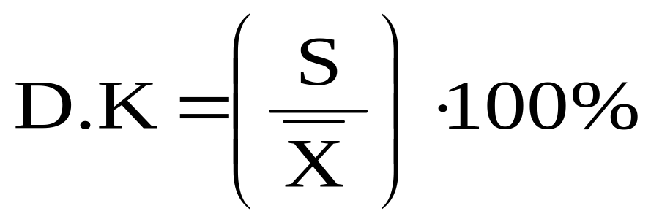
Değişkenlik Ölçüleri:
Değişkenlik Katsayısı
Kısmi değişimleri verir
Yüzde (%) olarak ifade edilir.
Farklı birimlerde ölçülen iki veya daha fazla değişkenin değişkenliğinin karşılaştırılmasını sağlar.
Basic Business Statistics, 11e © 2009 Prentice-Hall, Inc..
Chap 3-<number>

Slide 26
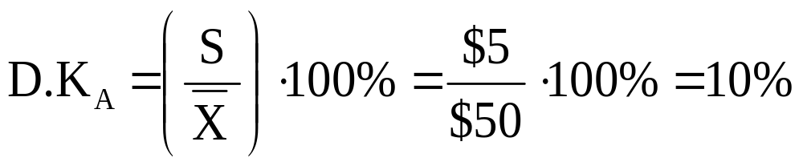
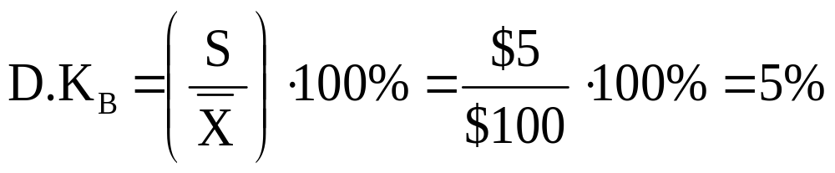
Değişkenlik Katsayısı
Stock A:
  Ortalama fiyat= $50
  Standart sapma = $5
Stock B:
  Ortalama Fiyat= $100
  Standart Sapma= $5
Her iki stokun st. Sapma değeri aynı ancak, B’nin değişkenliği ortalamasına göre daha dü
Basic Business Statistics, 11e © 2009 Prentice-Hall, Inc..
Chap 3-<number>

Slide 27
Locating Extreme Outliers:
Z-Score
To compute the Z-score of a data value, subtract the mean and divide by the standard deviation.
The Z-score is the number of standard deviations a data value is from the mean.
A data value is considered an extreme outlier if its Z-score is less than -3.0 or greater than +3.0.
The larger the absolute value of the Z-score, the farther the data value is from the mean.
Basic Business Statistics, 11e © 2009 Prentice-Hall, Inc..
Chap 3-<number>

Slide 28
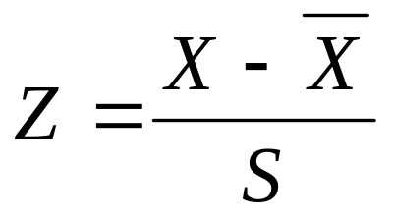
Locating Extreme Outliers:
Z-Score
where X represents the data value
X is the sample mean
S is the sample standard deviation
Basic Business Statistics, 11e © 2009 Prentice-Hall, Inc..
Chap 3-<number>

Slide 29
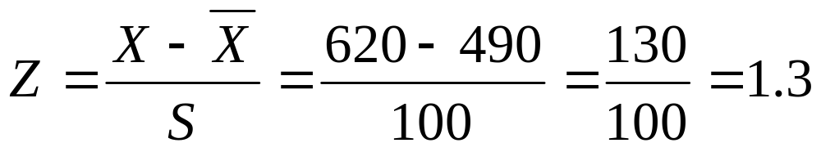
Locating Extreme Outliers:
Z-Score
Suppose the mean math SAT score is 490, with a standard deviation of 100.
Compute the Z-score for a test score of 620.
A score of 620 is 1.3 standard deviations above the mean and would not be considered an outlier.
Basic Business Statistics, 11e © 2009 Prentice-Hall, Inc..
Chap 3-<number>

Slide 30
Shape of a Distribution
Describes how data are distributed
Measures of shape
  Symmetric or skewed
Left-Skewed
Symmetric
Right-Skewed
Mean < Median
Mean = Median
Median < Mean
Basic Business Statistics, 11e © 2009 Prentice-Hall, Inc..
Chap 3-<number>

Slide 31
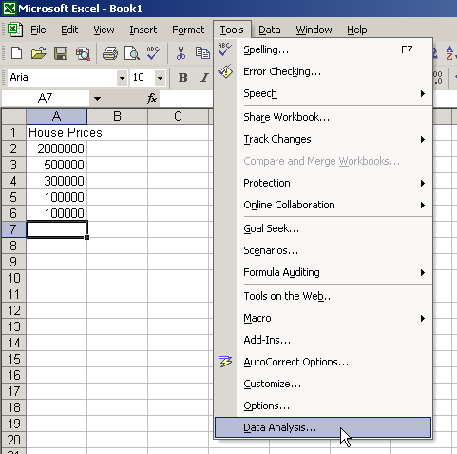
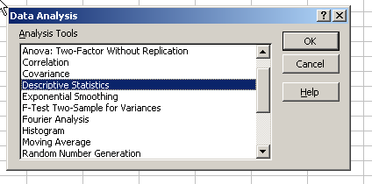
General Descriptive Stats Using Microsoft Excel
Select Tools.
Select Data Analysis.
Select Descriptive Statistics and click OK.
Basic Business Statistics, 11e © 2009 Prentice-Hall, Inc..
Chap 3-<number>

Slide 32
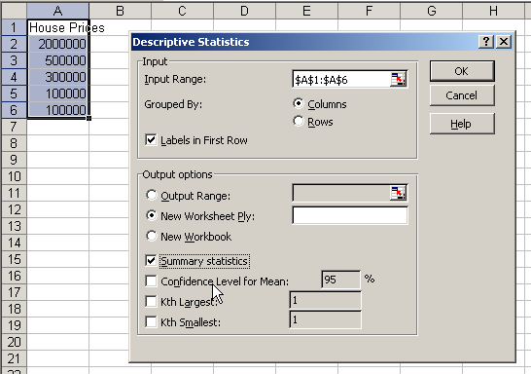
General Descriptive Stats Using Microsoft Excel
4. Enter the cell range.
5. Check the Summary Statistics box.
6. Click OK
Basic Business Statistics, 11e © 2009 Prentice-Hall, Inc..
Chap 3-<number>

Slide 33
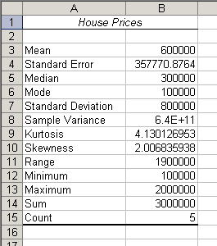
Excel output
Microsoft Excel
descriptive statistics output,
using the house price data:
House Prices:
$2,000,000
500,000
300,000
100,000
100,000
Basic Business Statistics, 11e © 2009 Prentice-Hall, Inc..
Chap 3-33

Slide 34
Minitab Output
Descriptive Statistics: House Price
Total
Variable Count Mean SE Mean StDev Variance Sum Minimum
House Price 5 600000 357771 800000 6.40000E+11 3000000 100000
N for
Variable Median Maximum Range Mode Skewness Kurtosis
House Price 300000 2000000 1900000 100000 2.01 4.13
Basic Business Statistics, 11e © 2009 Prentice-Hall, Inc..
Chap 3-<number>

Slide 35
Numerical Descriptive Measures for a Population
Descriptive statistics discussed previously described a sample, not the population.
Summary measures describing a population, called parameters, are denoted with Greek letters.
Important population parameters are the population mean, variance, and standard deviation.
Basic Business Statistics, 11e © 2009 Prentice-Hall, Inc..
Chap 3-<number>

Slide 36
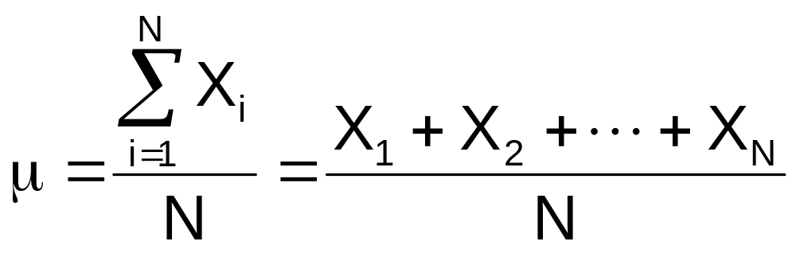
Numerical Descriptive Measures for a Population: The mean µ
The population mean is the sum of the values in the population divided by the population size, N
Where
μ = population mean
N = population size
X_{i} = i^{th} value of the variable X
Basic Business Statistics, 11e © 2009 Prentice-Hall, Inc..
Chap 3-<number>

Slide 37
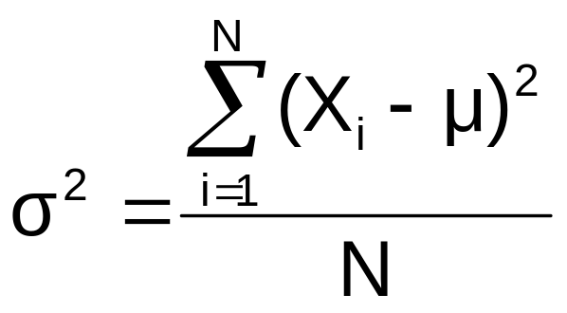
Numerical Descriptive Measures For A Population: The Variance σ²
Average of squared deviations of values from the mean
  Population variance:
Where
μ = population mean
N = population size
X_{i} = i^{th} value of the variable X
Basic Business Statistics, 11e © 2009 Prentice-Hall, Inc..
Chap 3-<number>

Slide 38
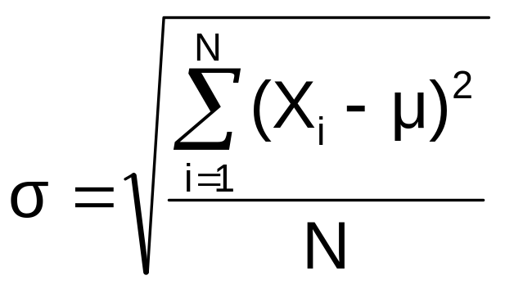
Numerical Descriptive Measures For A Population: The Standard Deviation σ
Most commonly used measure of variation
Shows variation about the mean
Is the square root of the population variance
Has the same units as the original data
  Population standard deviation:
Basic Business Statistics, 11e © 2009 Prentice-Hall, Inc..
Chap 3-<number>

Slide 39
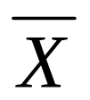





Sample statistics versus population parameters
Measure | Population Parameter | Sample Statistic
Mean
Variance
Standard Deviation
Basic Business Statistics, 11e © 2009 Prentice-Hall, Inc..
Chap 3-<number>

Slide 40
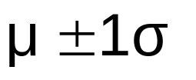


The Empirical Rule
The empirical rule approximates the variation of data in a bell-shaped distribution
Approximately 68% of the data in a bell shaped distribution is within 1 standard deviation of the mean or
68%
Basic Business Statistics, 11e © 2009 Prentice-Hall, Inc..
Chap 3-<number>

Slide 41


The Empirical Rule
Approximately 95% of the data in a bell-shaped distribution lies within two standard deviations of the mean, or µ ± 2σ
Approximately 99.7% of the data in a bell-shaped distribution lies within three standard deviations of the mean, or µ ± 3σ
95%
99.7%
Basic Business Statistics, 11e © 2009 Prentice-Hall, Inc..
Chap 3-<number>

Slide 42
Using the Empirical Rule
Suppose that the variable Math SAT scores is bell-shaped with a mean of 500 and a standard deviation of 90. Then,
  68% of all test takers scored between 410 and 590 (500 ± 90).
  95% of all test takers scored between 320 and 680 (500 ± 180).
  99.7% of all test takers scored between 230 and 770 (500 ± 270).
Basic Business Statistics, 11e © 2009 Prentice-Hall, Inc..
Chap 3-<number>

Slide 43
Chebyshev Rule
Regardless of how the data are distributed, at least (1 - 1/k²) x 100% of the values will fall within k standard deviations of the mean (for k > 1)
  Examples:
(1 - 1/2²) x 100% = 75% …........ k=2 (μ ± 2σ)
(1 - 1/3²) x 100% = 89% ………. k=3 (μ ± 3σ)
At least
within
Basic Business Statistics, 11e © 2009 Prentice-Hall, Inc..
Chap 3-<number>

Slide 44
Computing Numerical Descriptive Measures From A Frequency Distribution
Sometimes you have only a frequency distribution, not the raw data.
In this situation you can compute approximations to the mean and the standard deviation of the data
Basic Business Statistics, 11e © 2009 Prentice-Hall, Inc..
Chap 3-<number>

Slide 45
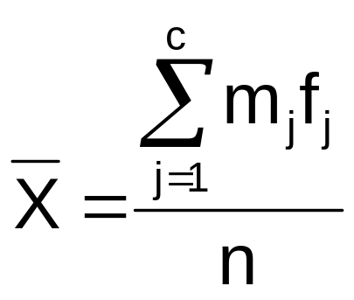
Approximating the Mean from a Frequency Distribution
Use the midpoint of a class interval to approximate the values in that class
  Where n = number of values or sample size
    c = number of classes in the frequency distribution
    m_{j} = midpoint of the j^{th} class
    f_{j} = number of values in the j^{th} class
Basic Business Statistics, 11e © 2009 Prentice-Hall, Inc..
Chap 3-<number>

Slide 46
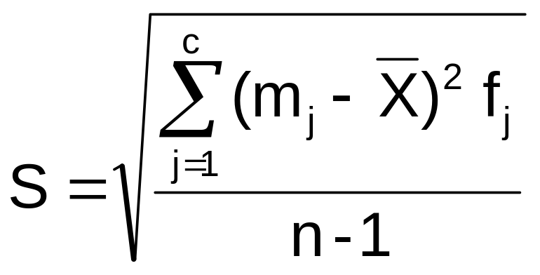
Approximating the Standard Deviation from a Frequency Distribution
Assume that all values within each class interval are located at the midpoint of the class
  Where n = number of values or sample size
    c = number of classes in the frequency distribution
    m_{j} = midpoint of the j^{th} class
    f_{j} = number of values in the j^{th} class
Basic Business Statistics, 11e © 2009 Prentice-Hall, Inc..
Chap 3-<number>

Slide 47
Quartile Measures
Quartiles split the ranked data into 4 segments with an equal number of values per segment
25%
25%
25%
25%
Q1
Q2
Q3
The first quartile, Q₁, is the value for which 25% of the observations are smaller and 75% are larger
Q₂ is the same as the median (50% of the observations are smaller and 50% are larger)
Only 25% of the observations are greater than the third quartile
Basic Business Statistics, 11e © 2009 Prentice-Hall, Inc..
Chap 3-<number>

Slide 48
Quartile Measures:
Locating Quartiles
Find a quartile by determining the value in the appropriate position in the ranked data, where
First quartile position: Q₁ = (n+1)/4 ranked value
Second quartile position: Q₂ = (n+1)/2 ranked value
Third quartile position: Q₃ = 3(n+1)/4 ranked value
where n is the number of observed values
Basic Business Statistics, 11e © 2009 Prentice-Hall, Inc..
Chap 3-<number>

Slide 49
Quartile Measures:
Calculation Rules
When calculating the ranked position use the following rules
  If the result is a whole number then it is the ranked position to use
  If the result is a fractional half (e.g. 2.5, 7.5, 8.5, etc.) then average the two corresponding data values.
  If the result is not a whole number or a fractional half then round the result to the nearest integer to find the ranked position.
Basic Business Statistics, 11e © 2009 Prentice-Hall, Inc..
Chap 3-<number>

Slide 50
Quartile Measures:
Locating Quartiles
Sample Data in Ordered Array: 11 12 13 16 16 17 18 21 22
(n = 9)
Q₁ is in the (9+1)/4 = 2.5 position of the ranked data
so use the value half way between the 2nd and 3rd values,
so Q₁ = 12.5
Q₁ and Q₃ are measures of non-central location
Q₂ = median, is a measure of central tendency
Basic Business Statistics, 11e © 2009 Prentice-Hall, Inc..
Chap 3-<number>

Slide 51
Quartile Measures
Calculating The Quartiles: Example
Sample Data in Ordered Array: 11 12 13 16 16 17 18 21 22
(n = 9)
Q₁ is in the (9+1)/4 = 2.5 position of the ranked data,
so Q₁ = (12+13)/2 = 12.5
Q₂ is in the (9+1)/2 = 5th position of the ranked data,
so Q₂ = median = 16
Q₃ is in the 3(9+1)/4 = 7.5 position of the ranked data,
so Q₃ = (18+21)/2 = 19.5
Q₁ and Q₃ are measures of non-central location
Q₂ = median, is a measure of central tendency
Basic Business Statistics, 11e © 2009 Prentice-Hall, Inc..
Chap 3-<number>

Slide 52
Quartile Measures:
The Interquartile Range (IQR)
The IQR is Q₃ – Q₁ and measures the spread in the middle 50% of the data
The IQR is also called the midspread because it covers the middle 50% of the data
The IQR is a measure of variability that is not influenced by outliers or extreme values
Measures like Q₁, Q₃, and IQR that are not influenced by outliers are called resistant measures
Basic Business Statistics, 11e © 2009 Prentice-Hall, Inc..
Chap 3-<number>

Slide 53
Calculating The Interquartile Range
Example:
Median
(Q₂)
X
X
Q₁
Q₃
minimum
maximum
25% 25% 25% 25%
12 30 45 57 70
Interquartile range
= 57 – 30 = 27
Basic Business Statistics, 11e © 2009 Prentice-Hall, Inc..
Chap 3-<number>

Slide 54
The Five Number Summary
The five numbers that help describe the center, spread and shape of data are:
  X_{smallest}
  First Quartile (Q₁)
  Median (Q₂)
  Third Quartile (Q₃)
  X_{largest}
Basic Business Statistics, 11e © 2009 Prentice-Hall, Inc..
Chap 3-<number>

Slide 55
Relationships among the five-number summary and distribution shape
Left-Skewed | Symmetric | Right-Skewed
Median – X_{smallest} > X_{largest} – Median | Median – X_{smallest} ≈ X_{largest} – Median | Median – X_{smallest} < X_{largest} – Median
Q₁ – X_{smallest} > X_{largest} – Q₃ | Q₁ – X_{smallest} ≈ X_{largest} – Q₃ | Q₁ – X_{smallest} < X_{largest} – Q₃
Median – Q₁ > Q₃ – Median | Median – Q₁ ≈ Q₃ – Median | Median – Q₁ < Q₃ – Median
Basic Business Statistics, 11e © 2009 Prentice-Hall, Inc..
Chap 3-<number>

Slide 56
Five Number Summary and
The Boxplot
The Boxplot: A Graphical display of the data based on the five-number summary:
X_{smallest} -- Q₁ -- Median -- Q₃ -- X_{largest}
Example:
25% of data 25% 25% 25% of data
of data of data
X_{smallest} Q₁ Median Q₃ X_{largest}
Basic Business Statistics, 11e © 2009 Prentice-Hall, Inc..
Chap 3-<number>

Slide 57
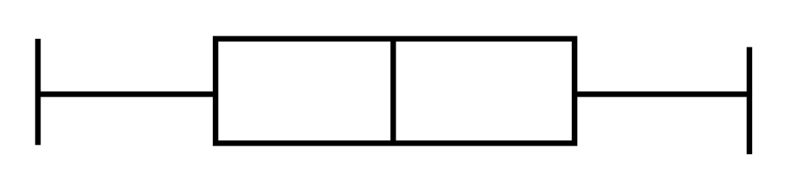
Five Number Summary:
Shape of Boxplots
If data are symmetric around the median then the box and central line are centered between the endpoints
A Boxplot can be shown in either a vertical or horizontal orientation
X_{smallest} Q₁ Median Q₃ X_{largest}
Basic Business Statistics, 11e © 2009 Prentice-Hall, Inc..
Chap 3-<number>

Slide 58
Distribution Shape and
The Boxplot
Left-Skewed
Symmetric
Right-Skewed
Q₁
Q₂
Q₃
Q₁
Q₂
Q₃
Q₁
Q₂
Q₃
Basic Business Statistics, 11e © 2009 Prentice-Hall, Inc..
Chap 3-<number>

Slide 59
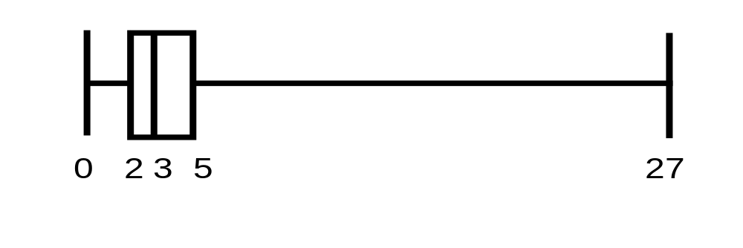
Boxplot Example
Below is a Boxplot for the following data:
0 2 2 2 3 3 4 5 5 9 27
The data are right skewed, as the plot depicts
X_{smallest} Q₁ Q₂ Q₃ X_{largest}
0 2 3 5 27
Basic Business Statistics, 11e © 2009 Prentice-Hall, Inc..
Chap 3-<number>

Slide 60
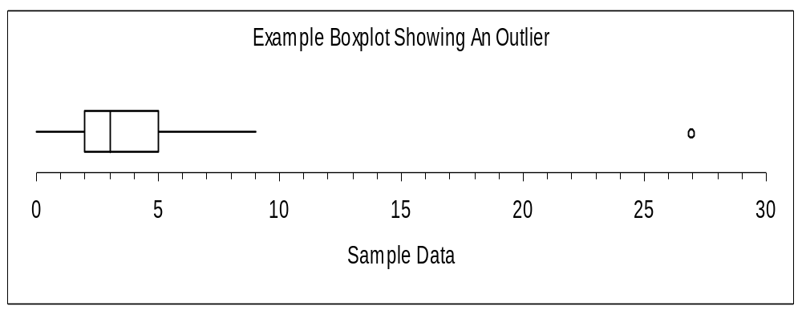
Boxplot example showing an outlier
The boxplot below of the same data shows the outlier value of 27 plotted separately
A value is considered an outlier if it is more than 1.5 times the interquartile range below Q₁ or above Q₃
Basic Business Statistics, 11e © 2009 Prentice-Hall, Inc..
Chap 3-<number>

Slide 61
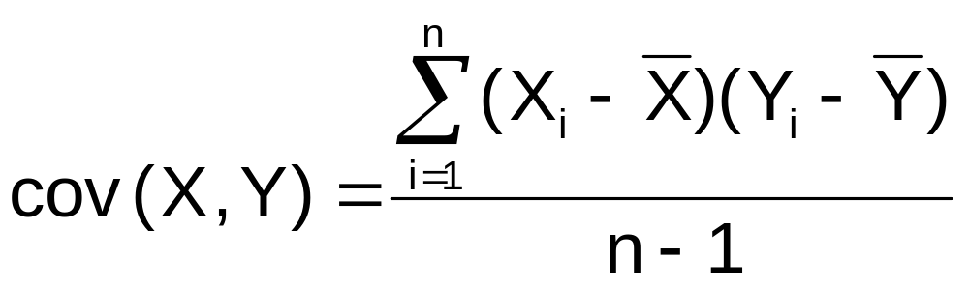
The Covariance
The covariance measures the strength of the linear relationship between two numerical variables (X & Y)
The sample covariance:
Only concerned with the strength of the relationship
No causal effect is implied
Basic Business Statistics, 11e © 2009 Prentice-Hall, Inc..
Chap 3-<number>

Slide 62
Interpreting Covariance
Covariance between two variables:
cov(X,Y) > 0 X and Y tend to move in the same direction
cov(X,Y) < 0 X and Y tend to move in opposite directions
cov(X,Y) = 0 X and Y are independent
The covariance has a major flaw:
  It is not possible to determine the relative strength of the relationship from the size of the covariance
Basic Business Statistics, 11e © 2009 Prentice-Hall, Inc..
Chap 3-<number>

Slide 63
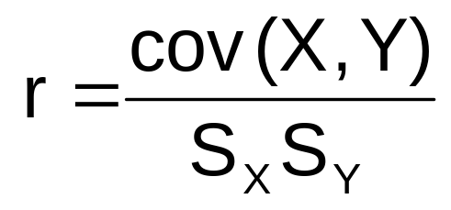
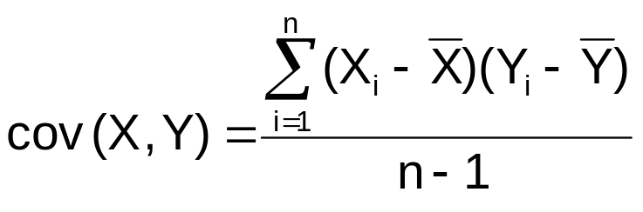
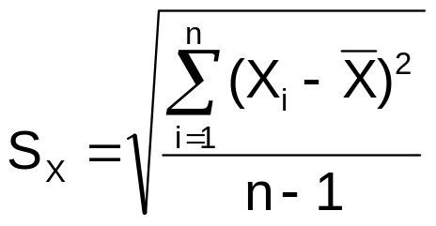

Coefficient of Correlation
Measures the relative strength of the linear relationship between two numerical variables
Sample coefficient of correlation:
where
Basic Business Statistics, 11e © 2009 Prentice-Hall, Inc..
Chap 3-<number>

Slide 64
Features of the
Coefficient of Correlation
The population coefficient of correlation is referred as ρ.
The sample coefficient of correlation is referred to as r.
Either ρ or r have the following features:
  Unit free
  Ranges between –1 and 1
  The closer to –1, the stronger the negative linear relationship
  The closer to 1, the stronger the positive linear relationship
  The closer to 0, the weaker the linear relationship
Basic Business Statistics, 11e © 2009 Prentice-Hall, Inc..
Chap 3-<number>

Slide 65
Scatter Plots of Sample Data with Various Coefficients of Correlation
Y
Y
X
X
r = -1
r = -.6
Y
Y
Y
X
X
X
r = +1
r = +.3
r = 0
Basic Business Statistics, 11e © 2009 Prentice-Hall, Inc..
Chap 3-<number>

Slide 66
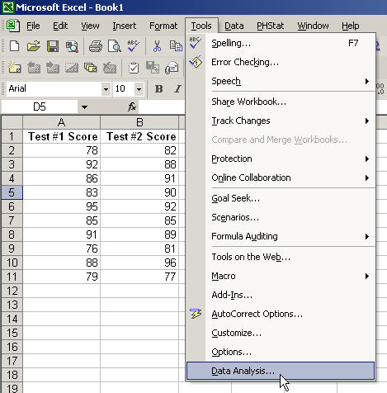
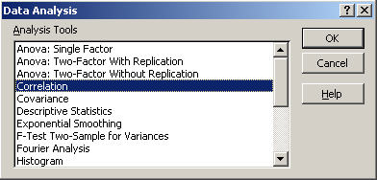
The Coefficient of Correlation
Using Microsoft Excel
Select Tools/Data Analysis
Choose Correlation from the selection menu
Click OK . . .
Basic Business Statistics, 11e © 2009 Prentice-Hall, Inc..
Chap 3-<number>

Slide 67
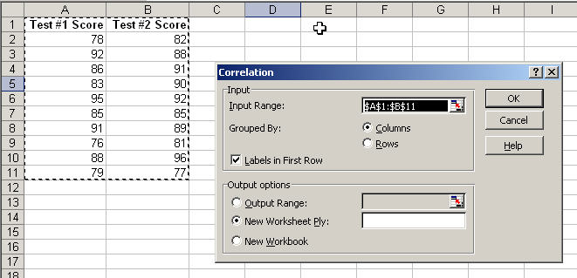

The Coefficient of Correlation
Using Microsoft Excel
Input data range and select appropriate options
Click OK to get output
Basic Business Statistics, 11e © 2009 Prentice-Hall, Inc..
Chap 3-<number>

Slide 68
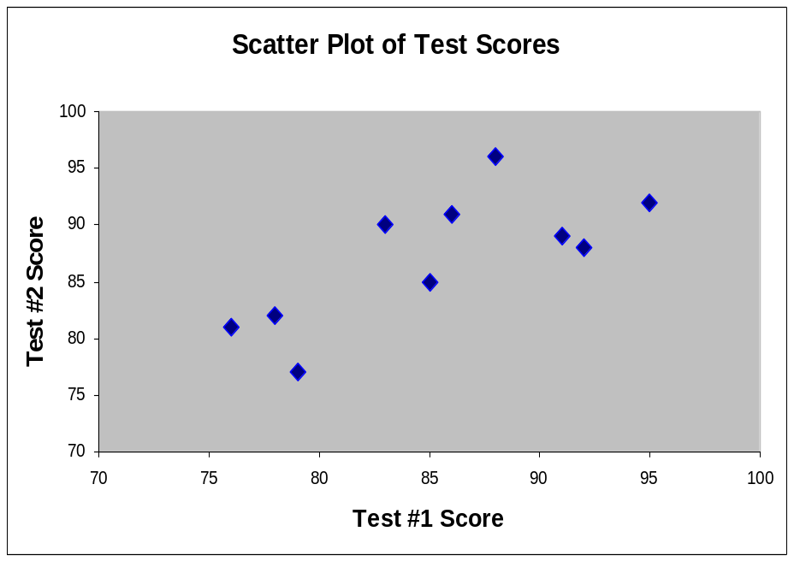
Interpreting the Coefficient of Correlation
Using Microsoft Excel
r = .733
There is a relatively strong positive linear relationship between test score #1 and test score #2.
Students who scored high on the first test tended to score high on second test.
Basic Business Statistics, 11e © 2009 Prentice-Hall, Inc..
Chap 3-<number>

Slide 69
Pitfalls in Numerical
Descriptive Measures
Data analysis is objective
  Should report the summary measures that best describe and communicate the important aspects of the data set
Data interpretation is subjective
  Should be done in fair, neutral and clear manner
Basic Business Statistics, 11e © 2009 Prentice-Hall, Inc..
Chap 3-<number>

Slide 70

Ethical Considerations
Numerical descriptive measures:
Should document both good and bad results
Should be presented in a fair, objective and neutral manner
Should not use inappropriate summary measures to distort facts
Basic Business Statistics, 11e © 2009 Prentice-Hall, Inc..
Chap 3-<number>

Slide 71
Chapter Summary
Described measures of central tendency
  Mean, median, mode, geometric mean
Described measures of variation
  Range, interquartile range, variance and standard deviation, coefficient of variation, Z-scores
Illustrated shape of distribution
  Symmetric, skewed
Described data using the 5-number summary
  Boxplots
Basic Business Statistics, 11e © 2009 Prentice-Hall, Inc..
Chap 3-<number>

Slide 72
Chapter Summary
(continued)
Discussed covariance and correlation coefficient
Addressed pitfalls in numerical descriptive measures and ethical considerations
Basic Business Statistics, 11e © 2009 Prentice-Hall, Inc..
Chap 3-<number>

